Slide 1


Slide 2
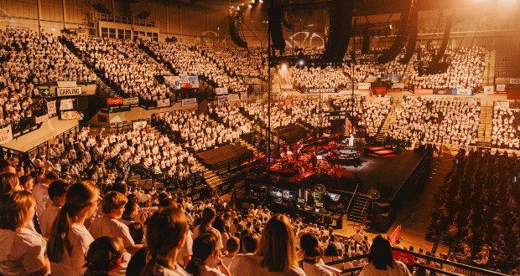
What is Young Voices?
Young Voices is a global children's choir that puts on large concerts featuring thousands of children.

Slide 3
What does being part of Young Voices involve?
Being part of our Young Voices Choir means attending every choir session in order for you to learn the many songs we will perform at the Young Voices concert.
We also learn dance moves and British sign language for some of the songs.

Slide 4
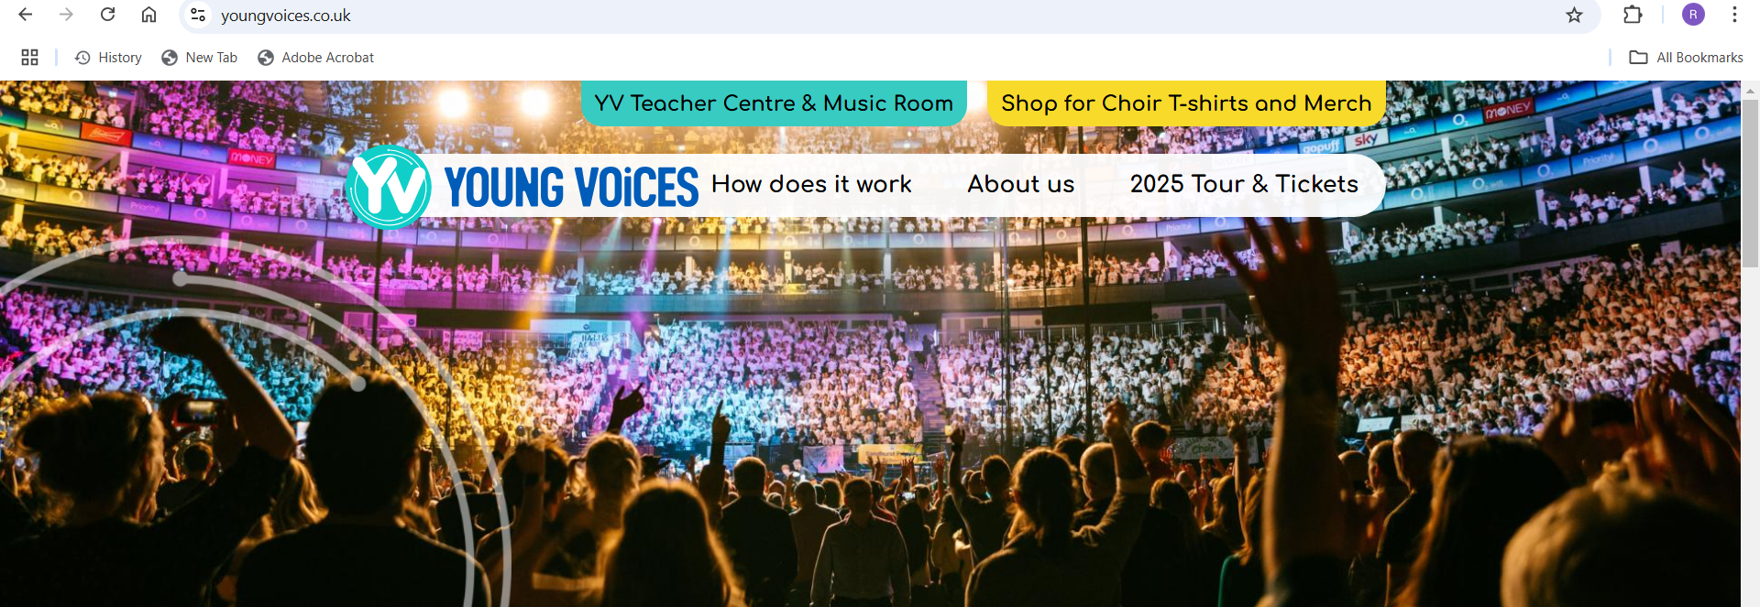
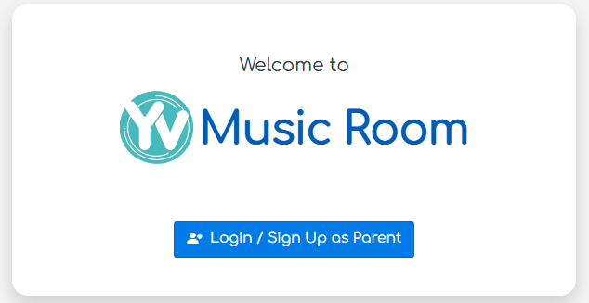
Young Voices Music Room
We will add you to the Young Voices Music Room based on the email address you provide.
Once you have signed up you will be able to access the Music Room for your child to be able to practice the songs and dance moves.

Slide 5
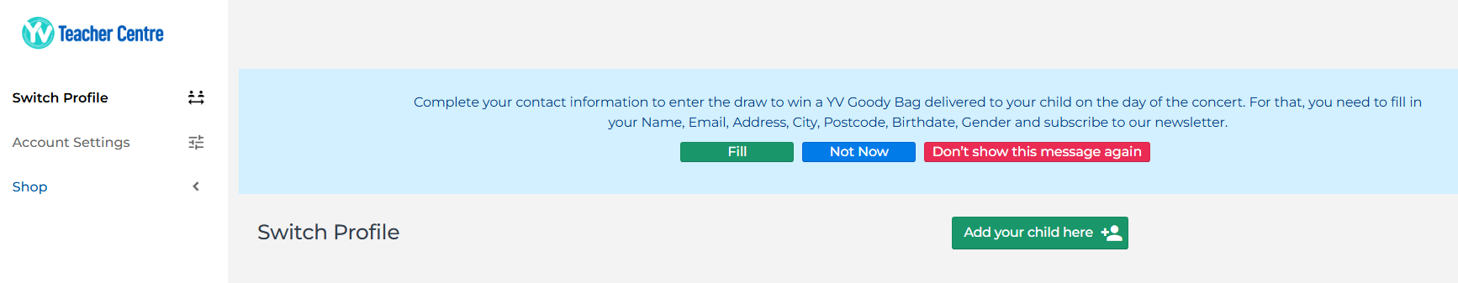
T shirt and Ticket orders
You will also be able to access the shop, where you can pay for tickets for the concert if you wish to attend. You do not need to purchase tickets for children who are part of the choir.

Slide 6

T shirt and Ticket orders
You will also be able to purchase a Young Voices t-shirt for your child to wear on the concert day. Children are not required to wear the young voice t-shirts for the concert, they will need to wear a plain white t-shirt on the day of the concert instead.
Closing date for tickets/t-shirt orders is 31st October 2025.
All tickets and t-shirt order will be delivered to school, this usually happens about 1-2 weeks before the concert date.
We will keep the t-shirts at school until the day of the concert.

Slide 7
Concert Date
The date for our concert will be,
Wednesday 28th January 2026
at Sheffield Arena

Slide 8
What happens on concert day?
8:50am - Children arrive at school wearing their uniform, as usual.
11:45am - Lunch (those who normally have school dinners will be given their hot meal at this earlier time)
12:15pm - Leave school
1.00pm –Choir arrive at Sheffield arena and are shown to their seats
2.00pm - Rehearsals
5.00pm - Dinner break - Children will need to bring a packed lunch and extra water/drinks would be useful as this has to last for the entire day.
6.00pm Children in their seats ready for the concert
7.00pm Concert starts
8.45pm Concert ends
10:00pm(ish!) - Arrive back at school (We will send a text with a more accurate ETA once our coach has left the arena – please look out for this message on the day).

Slide 9
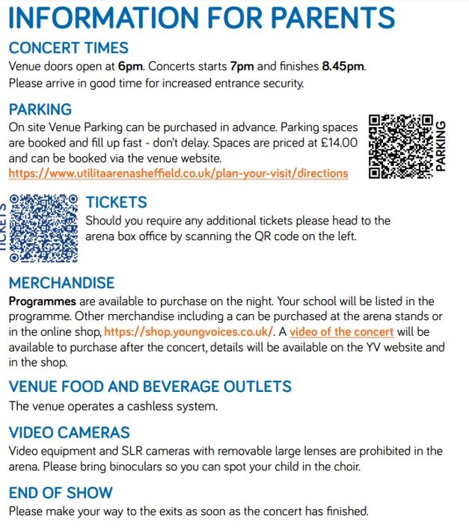
All children will return to school after the concert and will not be allowed to be collected from Sheffield Arena.
Parents/guardians coming to watch the concert will need to arrange their own transportation to the arena.
Due to the late return to school, we will keep registration for choir children and siblings open till 10am the next day, any children/ siblings who arrive after this time will receive a late mark.

Slide 10
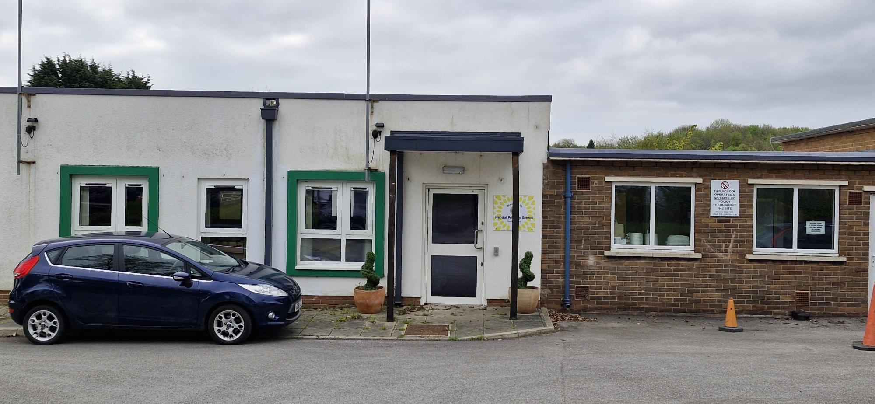
Choir
Choir will take place every Thursday from 3.15 to 4.15.
Starting on Thursday 5th June 2025 and the last choir practise will take part on Thursday 22nd January 2026.
Children will need to be collected from the music room door.
Add photo of the music room entrance

Slide 11


