Slide 1
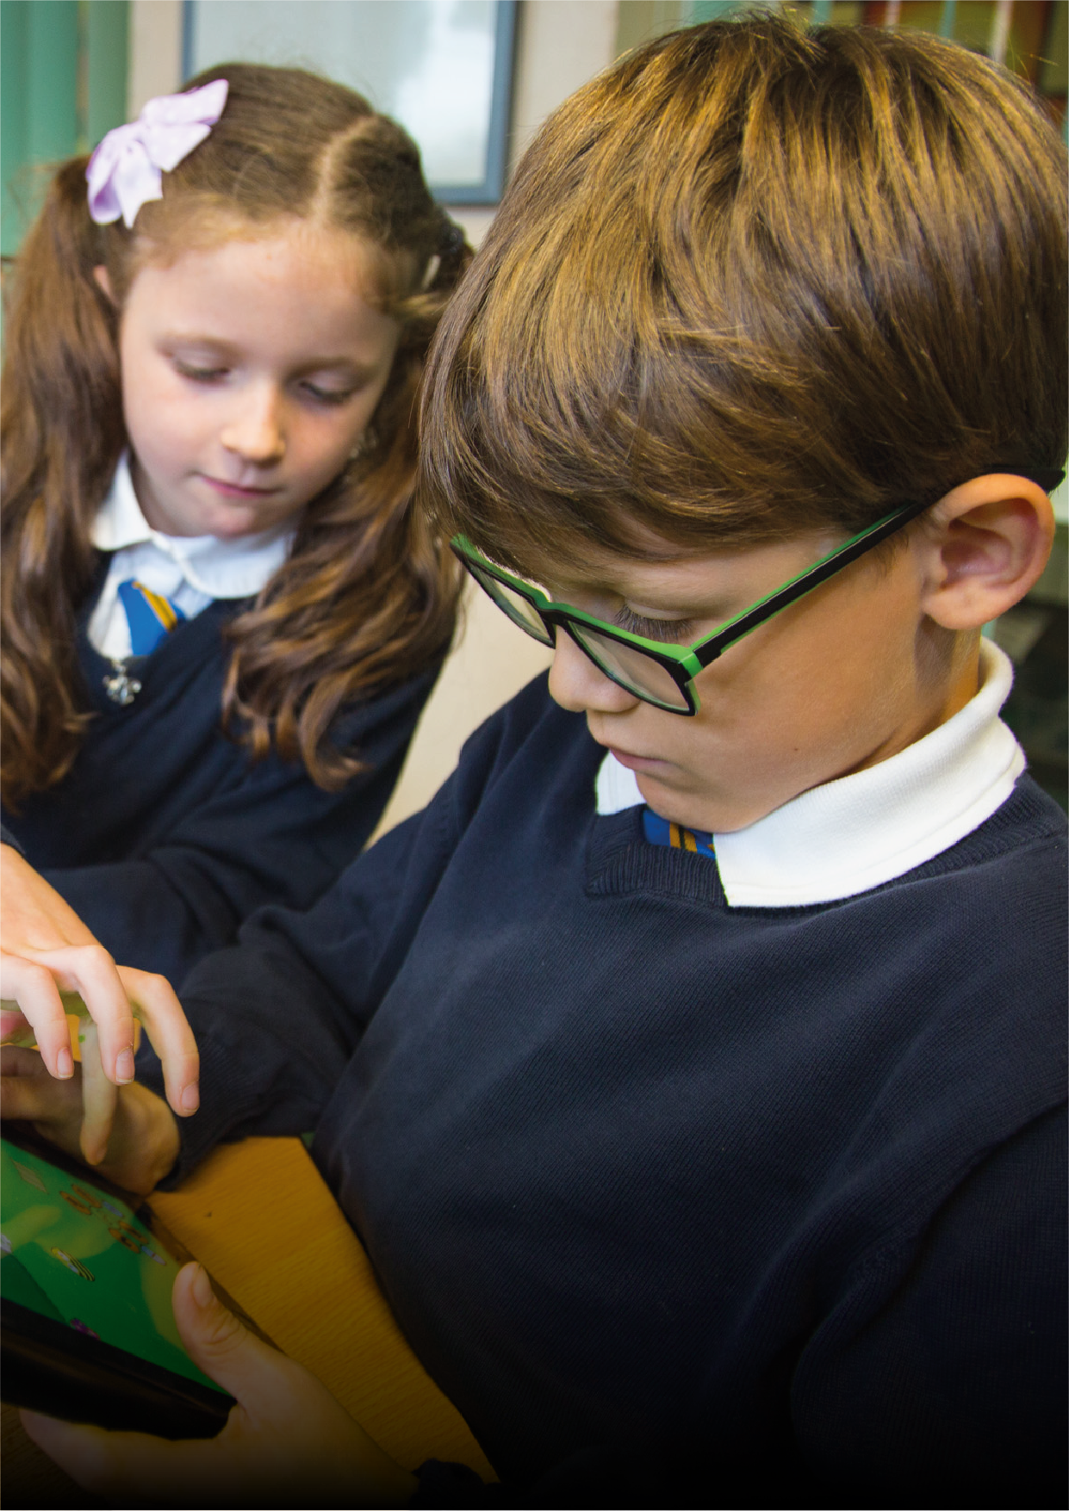


Curriculum
Booklet

Slide 2


Hendal Primary School
Hendal Lane,
Kettlethorpe,
Wakefield,
WF2 7QW
www.hendalprimary.org.uk

Slide 3

School
Curriculum
We teach an exciting curriculum and children tell us they enjoy learning and lessons.
We make many cross curricular links between subjects and offer a variety of experiential and active learning opportunities.
We personalise learning targets to meet the needs of every child.
English and Maths lessons are taught every day and English lessons are linked to the classes half termly novel. Maths lessons follow a Same Day Intervention approach where teachers mark books in lessons to enable them to give instant feedback to children. This allows children to respond to teachers comments instantly and make progress in every lesson. Other subjects we teach include: Science, Art and Design, Computing, Design and Technology, Geography, History, Modern Foreign Languages, Music, Physical Education and Religious Education and PSHE.

Slide 4
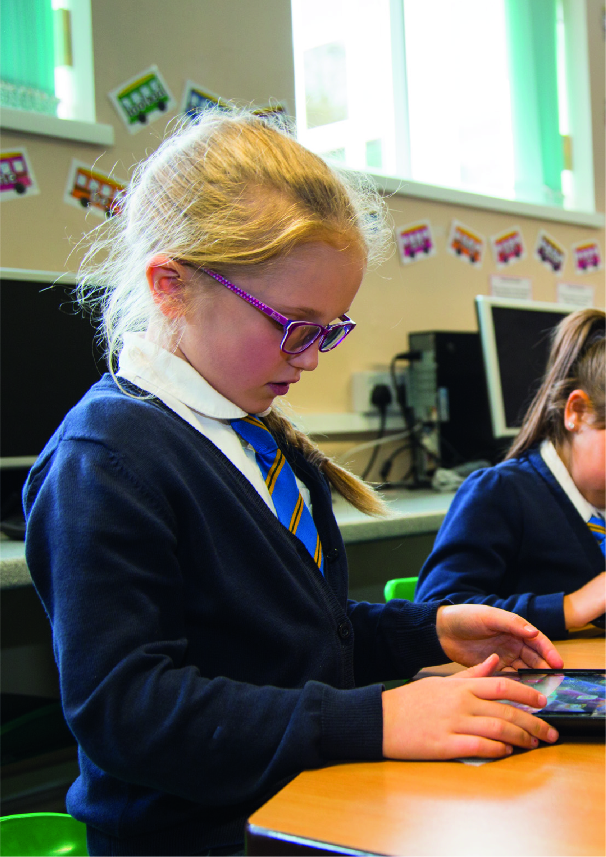

Slide 5
English
The National Curriculum divides English into:
Reading
• Word reading
• Comprehension (both listening and reading)
Writing
• Transcription (spelling and handwriting)
• Composition (articulating ideas and structuring them in speech and writing).
Spelling, Vocabulary, Grammar and Punctuation
To practice their developing reading skills, Upper Foundation and Key Stage 1 children take home letter sound keyrings literacy games, activities and tricky word lists. They take their reading books home each night to share with their parents/carers. This is known as Home/School Reading. We value the importance of early reading, children are taught through a systematic phonic scheme called Floppy’s Phonics. Our reading books are linked to the Floppy’s Phonics programme and reinforce the letter sounds the children know.
The Key Stage 1 library is open every week to allow parents to help their child choose a book to share at home. There is also a large Key Stage 2 library which is open every day and children can make frequent visits to change books, gather information from non fiction books and browse.
At Key Stage 2 children are encouraged to read widely, and to discuss and write about the books they have read with increasing perception. Parents are asked to provide valuable assistance with this development process.

Slide 6
Maths
The National Curriculum for mathematics aims to ensure that all pupils:
• Become fluent in the fundamentals of mathematics.
• Reason mathematically by following a line of enquiry.
• Can solve problems by applying mathematics to a variety of routine and non- routine problems.
Maths is a core subject and is divided into the following areas:
• Number
• Measurement
• Geometry
• Statistics
• Ratio and proportion (Year 6)
• Algebra (Year 6)
The programmes of study for mathematics are set out year by year for Key Stage 1 and 2.
Key Stage 1
Number:
Number and Place Value
Addition and Subtraction
Multiplication and Division
Fractions
Measurement
Geometry:
Properties of shapes
Position and direction
Statistics:
(Year 2 only)

Slide 7
Maths
Key Stage 2
Number:
Number and Place Value
Addition and Subtraction
Multiplication and Division
Fractions (including decimals and percentages)
Ratio and Proportion:
(Year 6)
Algebra:
(Year 6)
Statistics
Measurement
Geometry:
Properties of shapes
Position and direction.
Science
Science teaching in Key Stages 1 and 2 is based upon the National Curriculum Skills Programme.
The National Curriculum for science aims to ensure that all pupils:
• Develop scientific knowledge and conceptual understanding through the specific disciplines of biology, chemistry and physics.
• Develop understanding of the nature, processes and methods of science through different types of scientific enquiries that help them to answer scientific questions about the world around them.
• Are equipped with the scientific knowledge required to understand the uses and implications of science, today and for the future.
Children are required to work scientifically whilst learning about life processes and living things, materials and their properties, and physical processes.
Children tell us they enjoy developing their scientific skills whilst increasing their understanding of the role of science in society and the wider world. There is a big focus on increasing their scientific language and communication skills.
Apart from scientific apparatus and resources, the children of Hendal Primary benefit from their own nature and environmental areas, including a pond.

Slide 8
Art and Design
Art and Design is a National Curriculum Foundation subject. Children are encouraged to explore different techniques and media, of which a wide range is available. They are encouraged to observe their environment closely and represent it in an art form, as well as expressing their imagination.
Over the last few years, the school has achieved success in local competitions for art and design. We have also worked with the local Hepworth Art Gallery on a pupil print project. This reflects the quality of art teaching at the school and our children’s creations can be seen displayed around school.
Our inspiring Art Leader delivers training across the local authority.
Computing
Children have access to a wide range of applications of Information and Communication Technology.
They learn to apply skills in word processing, data handling and graphics. These skills are used to enhance work produced in other areas of the curriculum. We have a large computer suite and a mini suite outside the year 6 classrooms. All classrooms have an interactive whiteboard. We have two iPad trolleys for use in Years 2 and 3 and we have class sets of Chrome Books for use in Years 4, 5 and 6.
The school is linked to a computer network and to the Internet, which has a ‘fire wall’ to ensure relevant access and protection.

Slide 9
Design and Technology
Design and Technology is a National Curriculum Foundation subject. Children are encouraged to develop their design and technological capability by combining their designing and making skills with knowledge and understanding, in order to design and make products.
The children develop ideas first through discussion of an assignment related to a topic or theme in the classroom, they then record ideas using sketches or labelled drawings before the making stage.
Experience of simple tools, construction kits and a range of materials enable the children to turn their ideas into finished products. Discussion and evaluation of their design lead the children to think of further developments that could be made, and suggestions of alternative methods to improve their outcomes next time.
Geography
The National Curriculum Programmes of study for Geography is woven into our exciting whole school units of work. This ensures children are taught a broad and balanced curriculum.
Geography subject content:
Key Stage 1 and Key Stage 2
• Locational knowledge
• Place knowledge
• Human and Physical Geography
• Geographical skills and fieldwork

Slide 10
History
The National Curriculum Programmes of study for History are woven into our exciting whole school units of work. This ensures children are taught a broad and balanced curriculum.
History Subject Content:
Key Stage 1
Pupils should be taught about:
• Changes within living memory.
• Event beyond living memory that are significant nationally or globally.
• The lives of significant individuals in the past who have contributed to national and international achievements. Some should be used to compare aspects of life in different periods.
Key Stage 2:
Pupils should be taught about:
• Changes in Britain from the Stone Age to the Iron Age.
• The Roman Empire and its impact on Britain.
• Britain’s settlement by Anglo-Saxons and Scots
• A Viking and Anglo-Saxon struggle from the Kingdom of England to the time of Edward the Confessor.
• A local History study.
• A study of an aspect or theme in British history that extends pupils chronological knowledge beyond 1066.
• The achievements of the earliest civilisations.
• Ancient Greece.
• A non-European society that provides contrast with British History.

Slide 11
MFL
The National Curriculum for Languages aims to ensure that all pupils:
Understand and respond to spoken and written language from a variety of authentic sources.
Speak with increasing confidence, fluency and spontaneity, finding ways of communicating what they want to say, including through discussion and asking questions, and continually improving the accuracy of their pronunciation and intonation
Can write at varying length, for different purposes and audiences, using the variety of grammatical structures that they have learned
Discover and develop an appreciation of a range of writing in the language studied.
MUSIC
Music is a National Curriculum Foundation subject. The requirements are met through class music activities and through extra curricular opportunities.
We have received the Sing Up Platinum Award for the very high standard of singing across school.
Our music teacher visit the school each week to teach individual and group instrumental lessons. Our year 3 children learn to play the ukulele during class lessons.
Swimming
Children in year 5 have a weekly swimming lesson. We use the pool at Wakefield, travelling there by coach. Children are grouped according to ability and are encouraged to progress through the award levels.

Slide 12
Physical Education
PE is very important at Hendal Primary School. We offer a high quality curriculum that includes the cross-curricular approaches to health, fitness and leadership. We offer a wide range of sporting activities where children enjoy communicating, collaborating and competing with each other.
Our aim is to develop pupils’ range of physical activities whilst promoting positive attitudes towards active and healthy lifestyles.
Physical Education is a National Curriculum Foundation subject. We are fortunate in having a well-equipped gym, a large school field and extensive playgrounds.
The school has been awarded with the prestigious School Games Mark Gold Award and most recently the Change for Life Gold Award.
Children in Key Stage 2 run the one mile a day challenge and the school record is 6 minutes 22 seconds.
Religious Education
Religious Education is a legal requirement and is the responsibility of the Local Authority.
School follow the Wakefield’s Agreed Syllabus and RE lessons are creative, thought evoking and fun!
An act of collective worship takes place daily in the form of assemblies led by the Headteacher, teachers or visitors.
Parents have the right to withdraw children from Religious Education and assemblies.

Slide 13
More about our broad and balanced curriculum
Belong. Aspire. Achieve
Raising Standards
We aim to raise standards through the engaging curriculum we offer. Starting with a local context it is tailored to meet the needs and interests of our pupils.
Throughout the year units of work are introduced to challenge and extend pupils knowledge and understanding as well as increase their experiences of the wider world.
We make strong links between literacy and reading and the curriculum and children regularly read aloud, recite poetry and take part in drama activities which they tell us they enjoy. We pre teach subject specific vocabulary in order to equip children with the language they need to access the curriculum. Our reasoning, problem solving and times tables knowledge is fostered through our Going for Gold and Same Day intervention approaches to mathematics. Our Diamond Dash timestables challenge is hugely popular with our children.
We have high expectations of our pupils learning and behaviour and of the curriculum we offer on a day to day basis. Our strong assessments lead to the progression and mastery of skills in English, Maths and across the foundation subjects teachers we take our responsibility for subject leadership seriously and pupil’s voice helps shape the vision for further curriculum development.
As a school we are mindful of the need for our pupils to be lifelong learners and for the acquisition of skills to enable them to be successful in future employment.
Our children enjoy learning through a rich and varied curriculum that encourages and inspires them to achieve.
We want children to have a memorable experience at Hendal Primary School so they can grow up to be confident and independent citizens and make a positive contribution to society.

Slide 14
