Slide 1
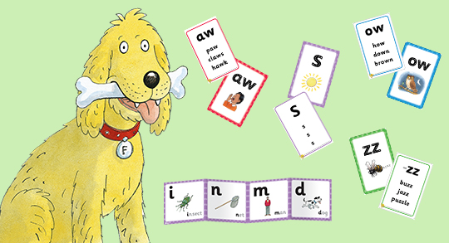
Guide to how we teach Phonics

Slide 3
This has been running for 4 years now at Hendal Primary and is having a positive impact on children’s reading.

Slide 4
Children begin to build on their sound awareness from an early age.
Listening for environmental sounds and oral Blending and Segmenting starts in nursery!
You can say “Can you pull up the /z/i/p/ of your /c/oa/t/”
Or… “Have you got your “/s/p/oo/n/”
This will help your child’s awareness of sounds.

Slide 5
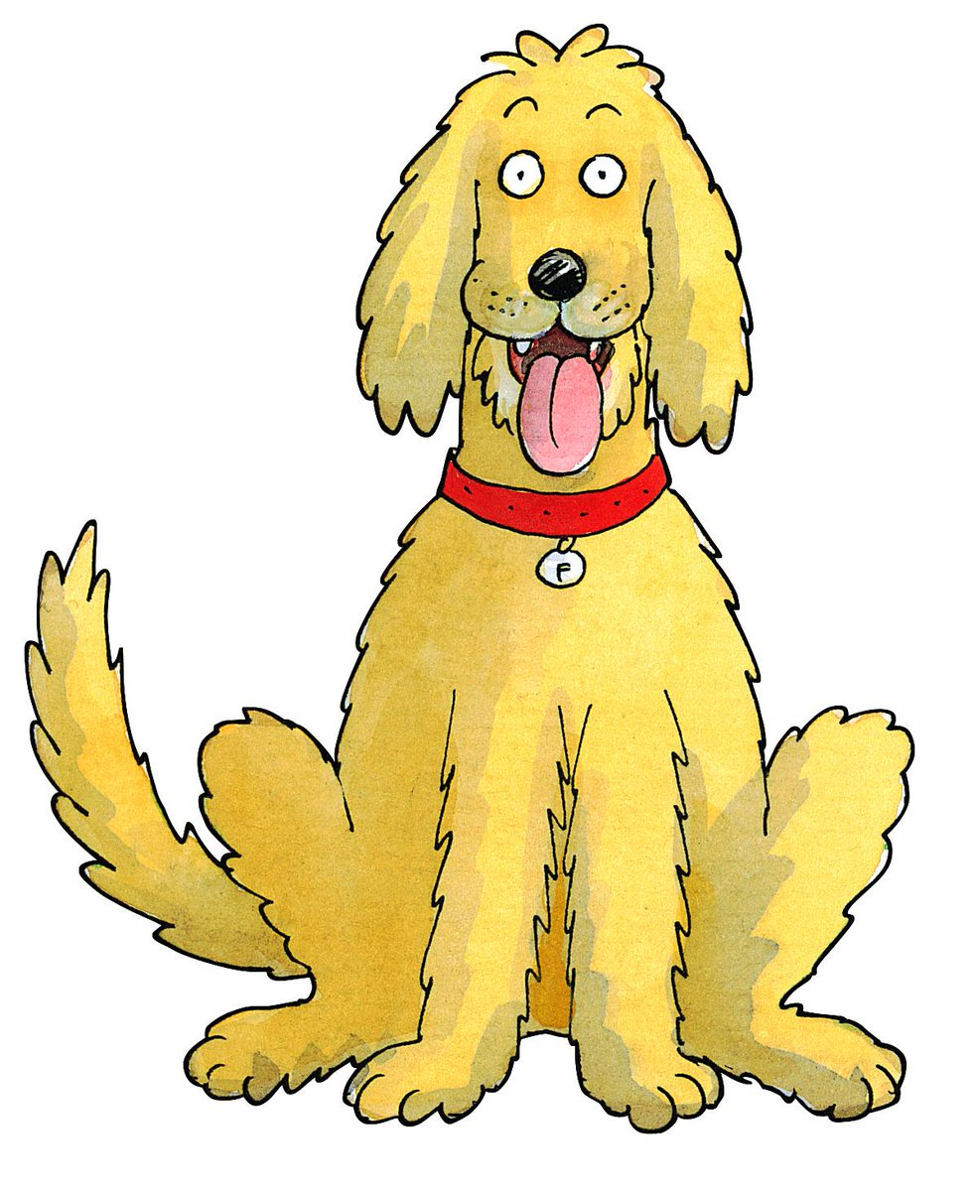
Which sounds will my child learn in Reception?

Slide 6
Level 1+ – Reception

Slide 7
Level 2 – Reception

Slide 8
Level 3 – End of Reception & Year 1

Slide 9
Key Vocabulary-
(Your child may know these words)
Phoneme: the sound a letter makes
Grapheme: the way we write a phoneme
Digraph: two letters that make one sound
Trigraph: three letters that make one sound

Slide 11
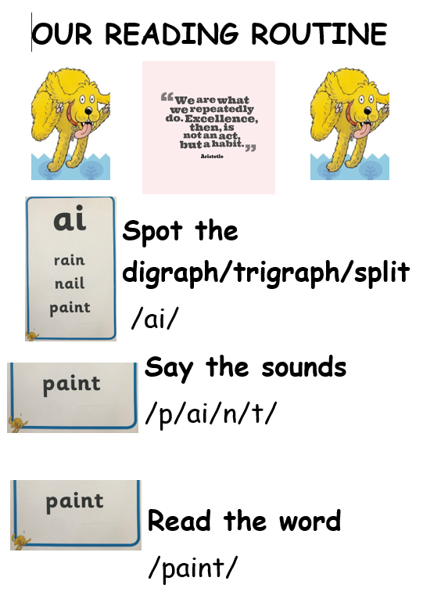
Reading Routine across school
All books given to children are fully decodable – this means they can use their Reading Routine to help them read any unfamiliar words. their reading routine to

Slide 12
Helping at home….
Spelling words….
This will really support your child with their writing too!

Slide 14
When will my child come home with a book?

Slide 15
Reading at home – Please listen to your child read every night!
Keyrings help children practise their blending skill and reinforce the sounds learnt
Does your child understand what they have read? Can they answer questions about the text?
Can they put they story into their own words?

Slide 16
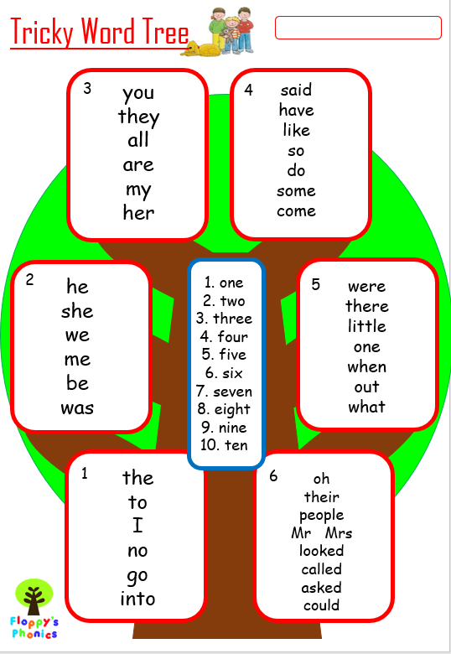
Tricky Words
These are words that cannot be sounded out…children just have to remember them! These words will appear in your child’s reading books.
The links below take you to of the songs we sing in class to help us learn to read tricky words (words that can not be sounded out).
https://www.youtube.com/watch?v=TvMyssfAUx0
https://www.youtube.com/watch?v=R087lYrRpgY
https://www.youtube.com/watch?v=3NOzgR1ANc4

Slide 17
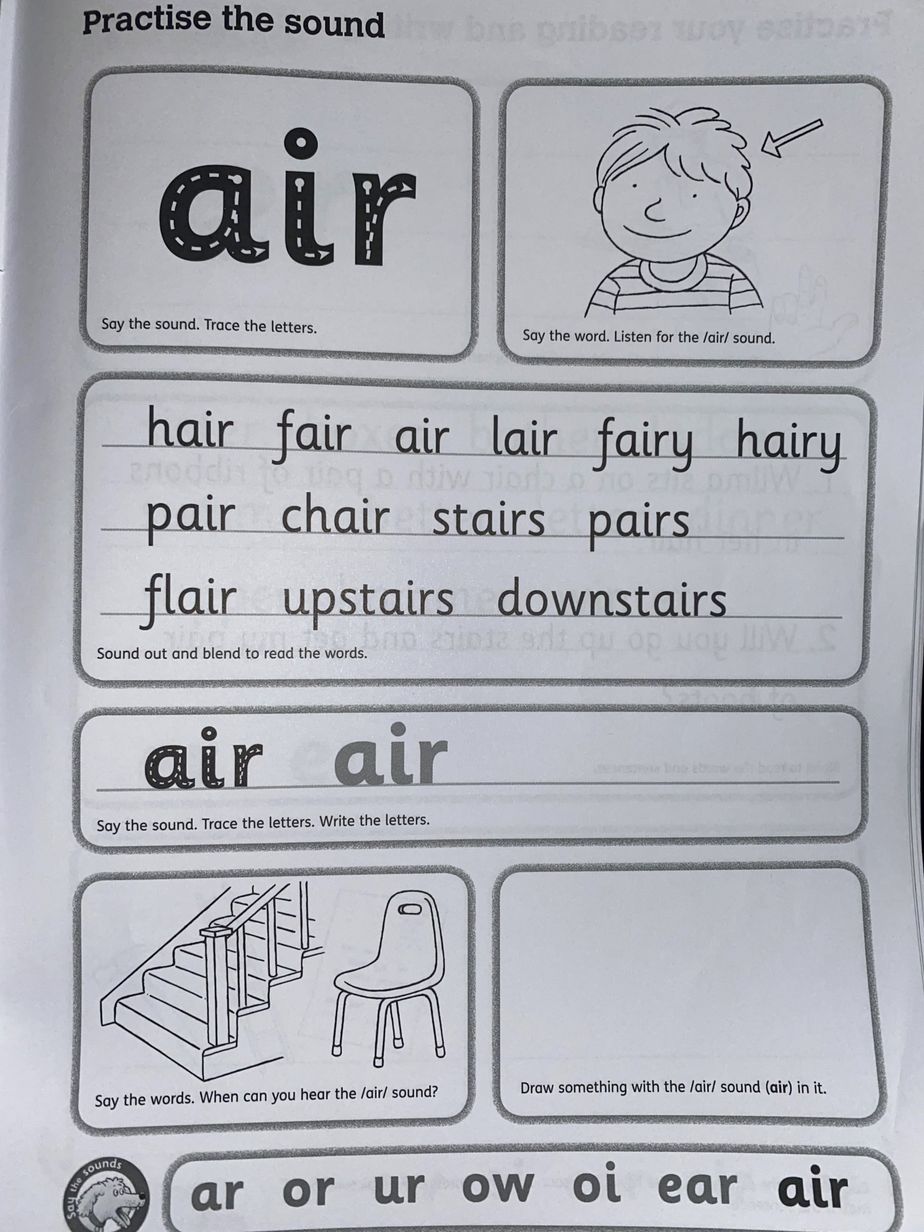
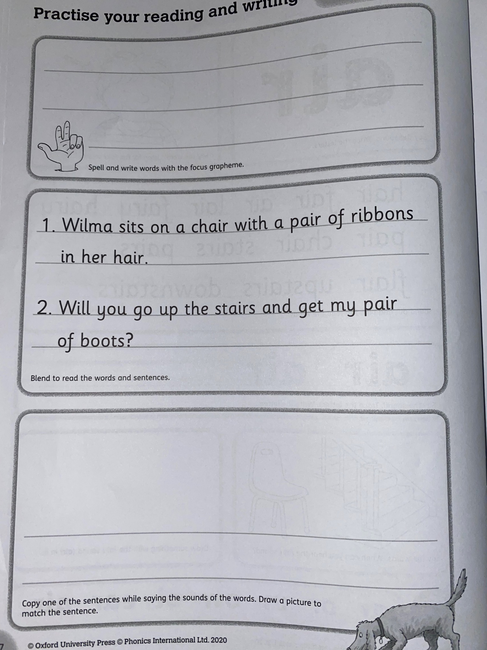
Our work books look like this…children complete this sheet in school first before it gets send home for extra practise.

Slide 18
Any questions?
Thank you for coming!

