Slide 1
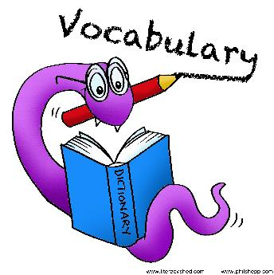
Today we are going to focus on

Slide 2
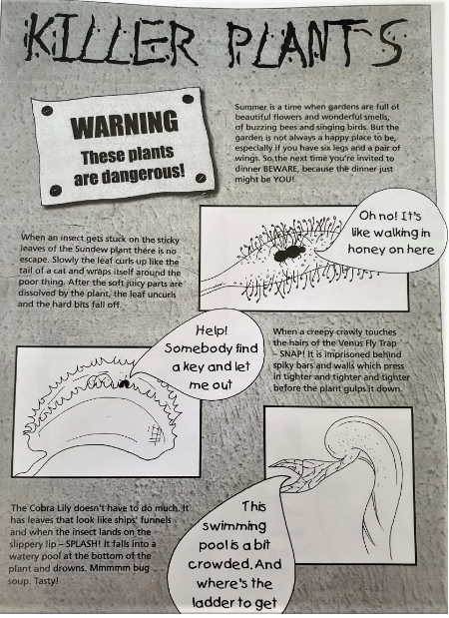
Look at our text today.
Do you think the text is fiction, non-fiction or poetry?
What do you think it is about?

Slide 3
Warm up discussion questions
What do you think we will be reading about?
What type of book would you find this text in, a history or science book? Why do you think that?
Notes:
No recording just questions to ask.

Slide 4
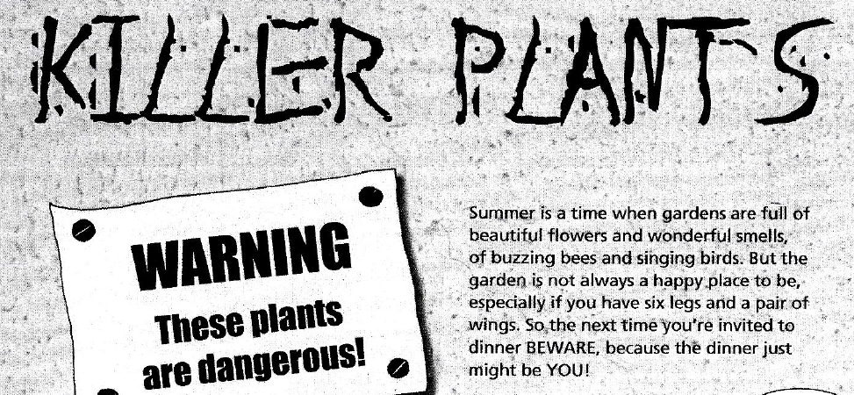
Read the whole text

Slide 5
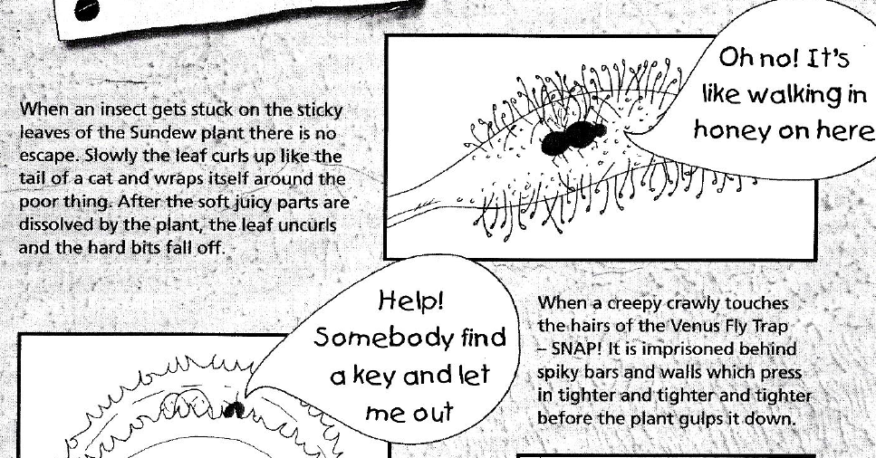

Slide 6
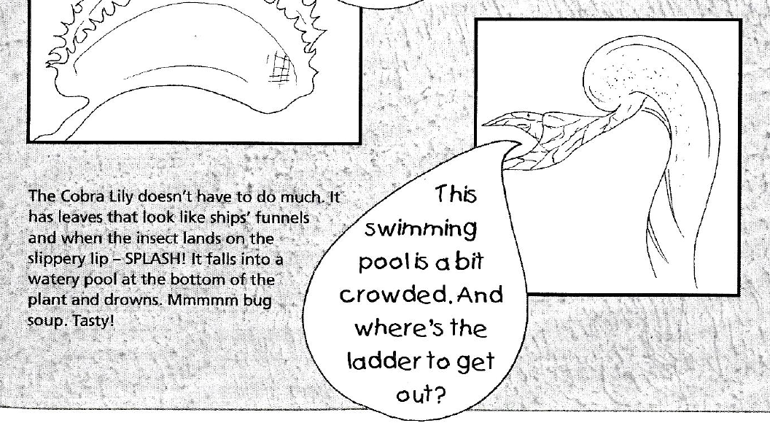

Slide 7
1. Find the word dangerous. What word can you see at the start of this word?
danger

Slide 8
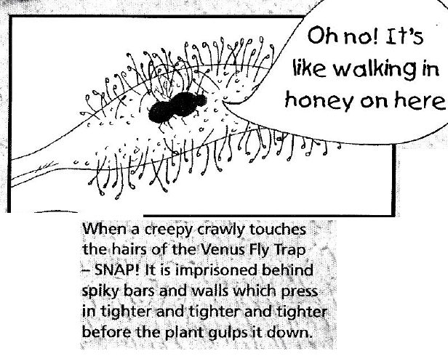
2. Find a word that tells us the bars of the Venus fly trap are sharp to an insect?
spiky

Slide 9
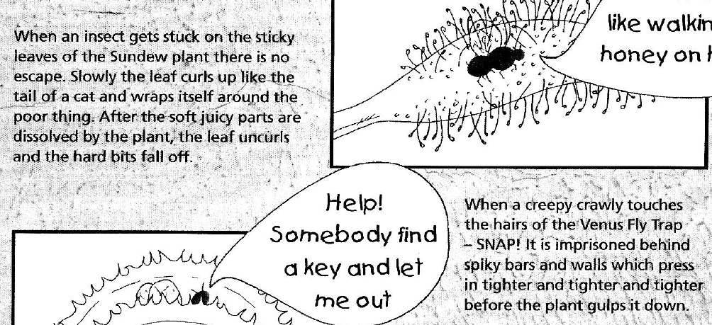
3. Look at paragraphs 2 and 3. Find another word for ‘mini beast’?
Insect, creepy crawly

Slide 10
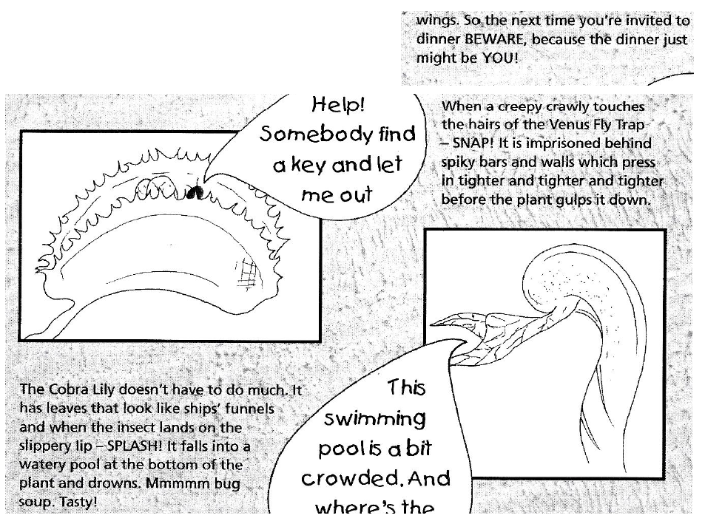
4. There are four words written in capitals. What are they?
BEWARE
YOU
SNAP
SPLASH

Slide 11
5. Which one of these word; BEWARE YOU SNAP SPLASH is?
a warning?
a fast word?
a noisy word?
BEWARE
SNAP
SPLASH

