Slide 1
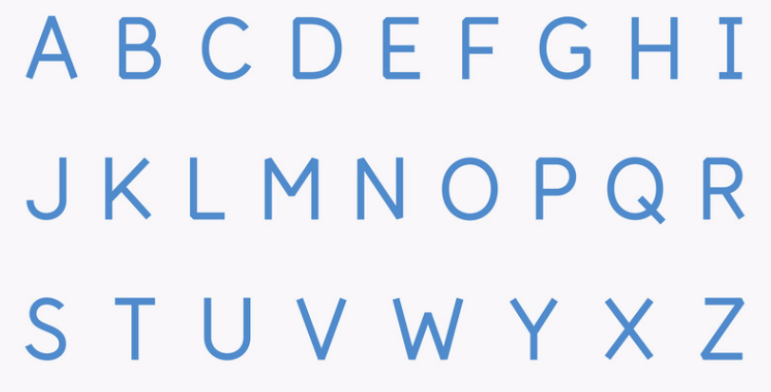
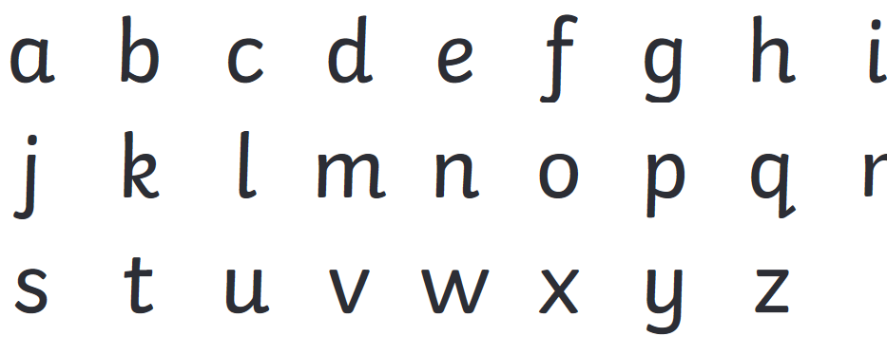
We are learning about capital letters today.
Which box below shows capital letters?

Slide 2
We are learning about capital letters today.
Which box below shows capital letters?

Slide 4
Task 1- Sort the letters below into the table.
Capital letters |  |  | Lower case letters
A
f
C
L
D
O
g
n
m
w
a
s
B
T

Slide 5
Check your answer
Capital letters |  |  | Lower case letters
A | D |  | f | m
C | O | T | g | w | s
L | B |  | n | a

Slide 6
Task 2- Match the capital letters to their lower case letters.
B |  | d
u |  | b
D |  | M
m |  | U

Slide 7
Check your answer
B |  | d
u |  | b
D |  | M
m |  | U

Slide 8
Task 3- Write the lower case letters below as capital letters.
w
b
g
c
d

Slide 9
Check your answer
w
b
g
c
d
W
B
G
C
D

Slide 10
Task 4- Write these words starting with a capital letter.
monday |  | july |  | i
sam |  | miss |  | the

Slide 11
Check your answer
monday |  | july |  | i
sam |  | miss |  | the
Monday |  | July |  | I
Sam |  | Miss |  | The

Slide 12
Task 5- Rewrite the sentences, starting with a capital letter.
the boy went to the park.
mum had a chat with dad.

Slide 13
Check your answer
The boy went to the park.
Mum had a chat with dad.

Slide 14
Independent Task – Complete the task on the worksheet or on a piece of paper.

Slide 15
Independent Task

Slide 16
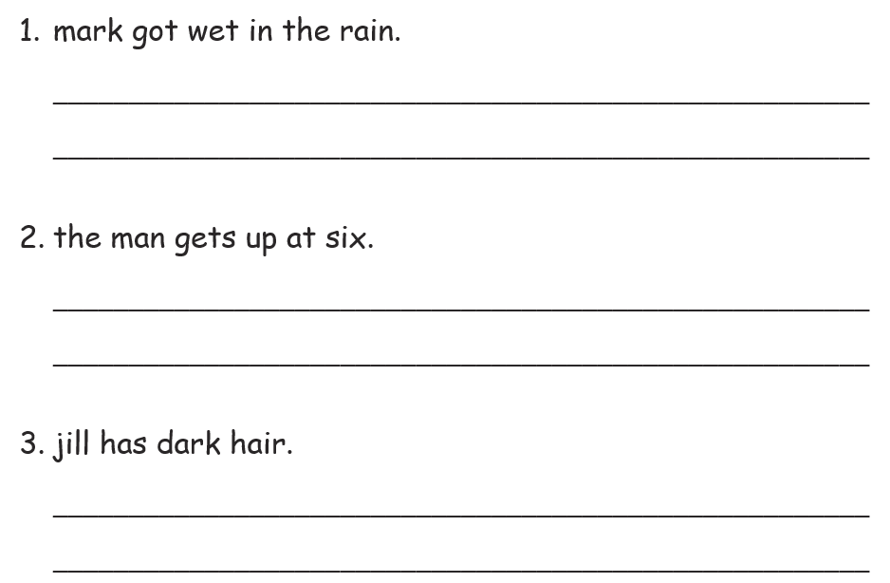
Independent Task - Read these sentences. Write each one again with a capital letters in the right places.

Slide 17
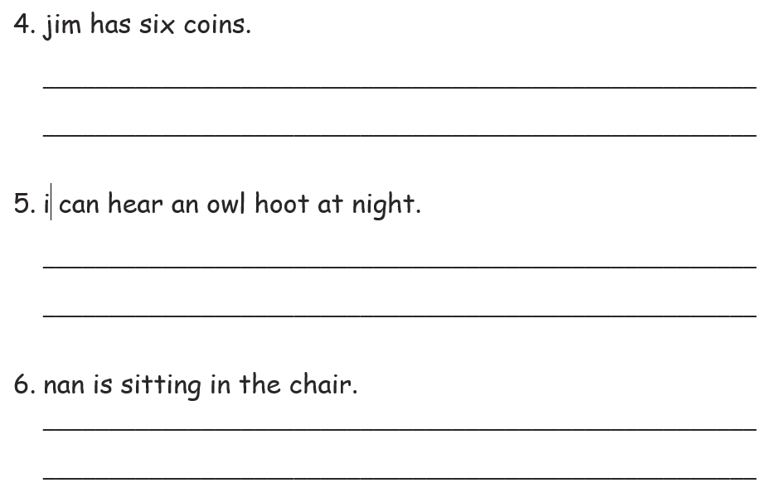
Independent Task - Read these sentences. Write each one again with a capital letters in the right places.

