Slide 1
Spelling starter
Copy out these sentences and add the missing word.

Slide 2
We are learning about Venice so that we can use a spider diagram to write factual sentences.

Slide 3
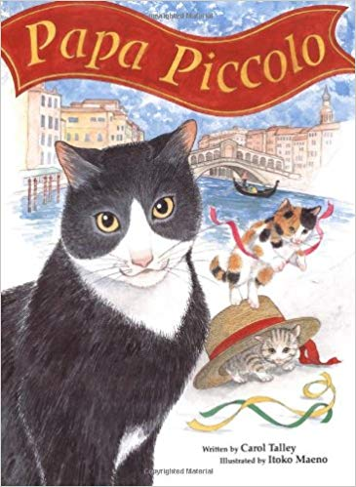
Yesterday we read the first part of the text of Papa Piccolo.
Where was our reading comprehension text set?
In English next week, we are going to imagine that we are on holiday in Venice, and write a postcard from there.
However before we think about writing our postcard we need to learn Venice.

Slide 4
From what we have read in the text Papa Piccolo so far, what have we already learnt about Venice?

Slide 5
Today you are going to learn about the Venice. In you book draw a spider diagram. As we learn about the Venice you can record them on your spider diagram.
Venice

Slide 6
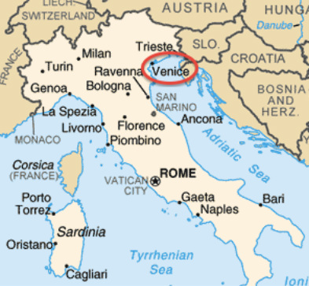
Where is the Venice?
Venice is a city in the North East of Italy. It was built about 1500 years ago.

Slide 7
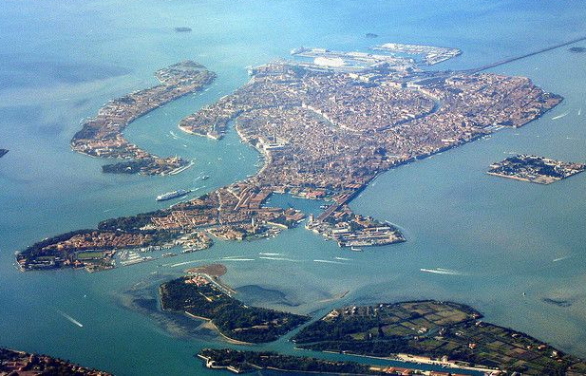
What do you notice about Venice?

Slide 8
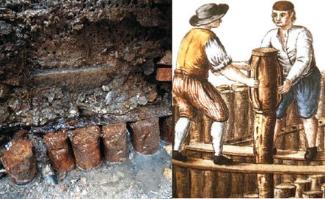
Venice is a city built on water and is sometimes called the floating city. Venice is made up of 118 islands, located in the Venetian Lagoon and is a world heritage site.
The buildings in Venice were not built directly on the islands. Instead, they were built upon wooden platforms that were supported by wooden stakes driven into the ground.

Slide 9
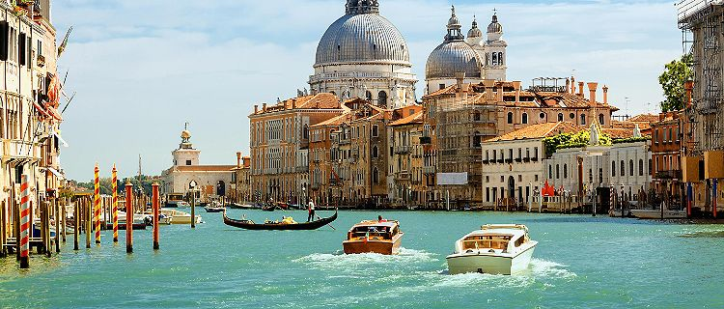
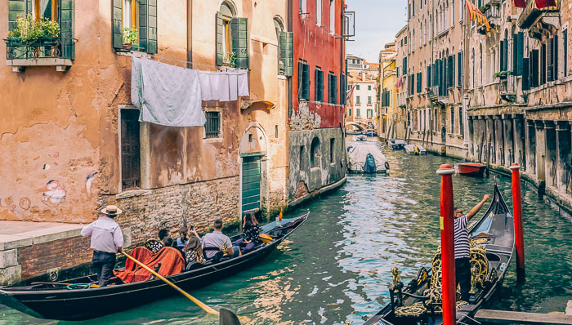
What is special about Venice?
The houses don’t overlook roads but water canals and the people who live there use boats instead of cars.

Slide 10
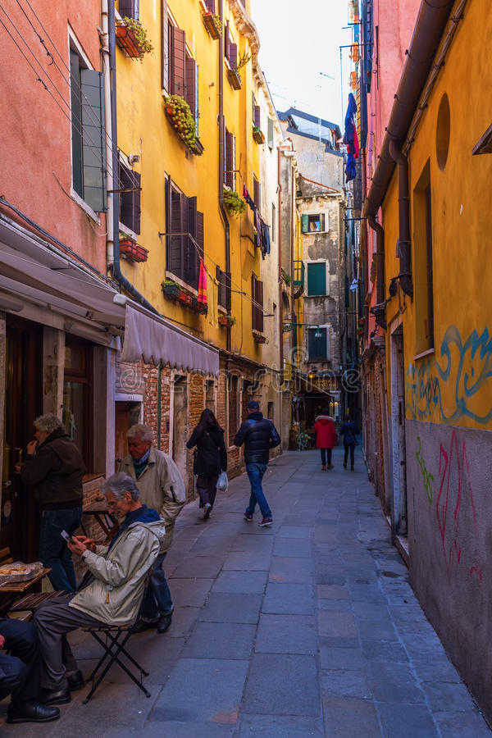
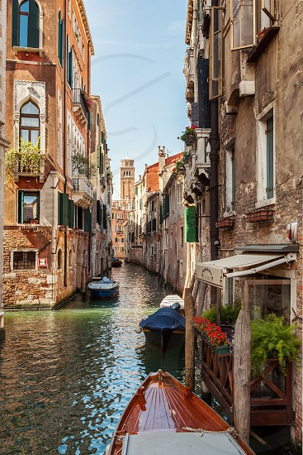
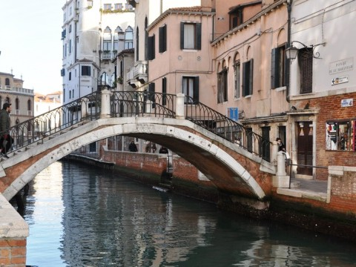
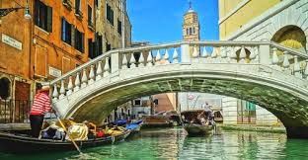
Venice has
2650 alleys
182 named canals
Venice has 417 bridges. 72 of these bridges are private. Most of the bridges don't have steps as they were built when horses were used for transportation.
139 churches

Slide 11
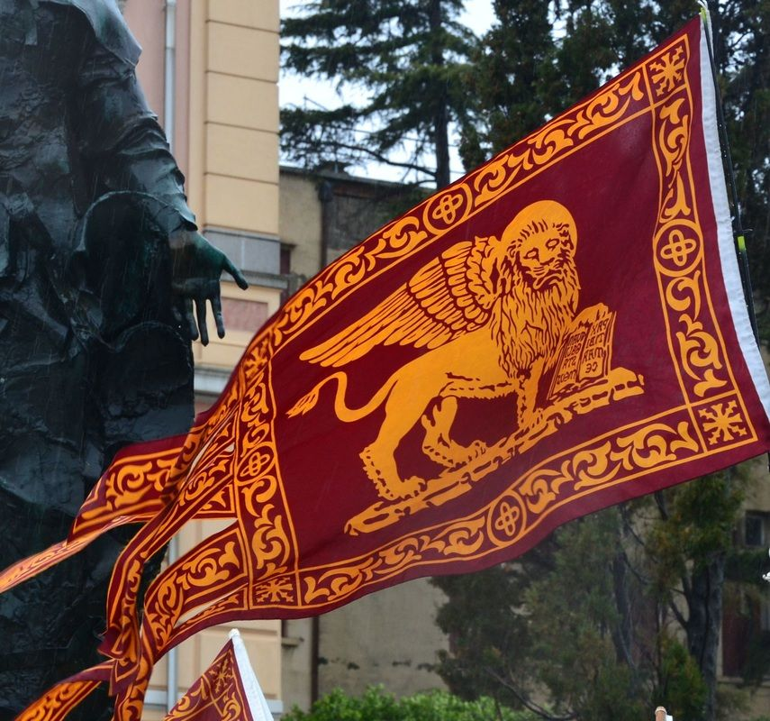
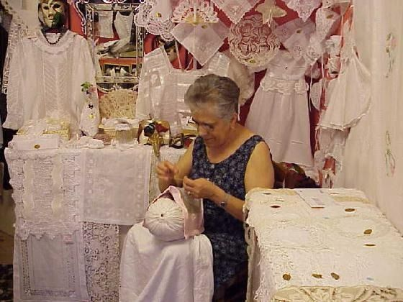
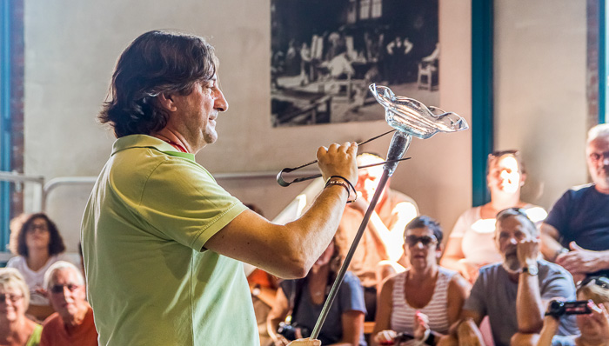
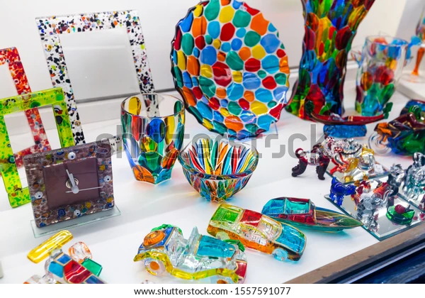
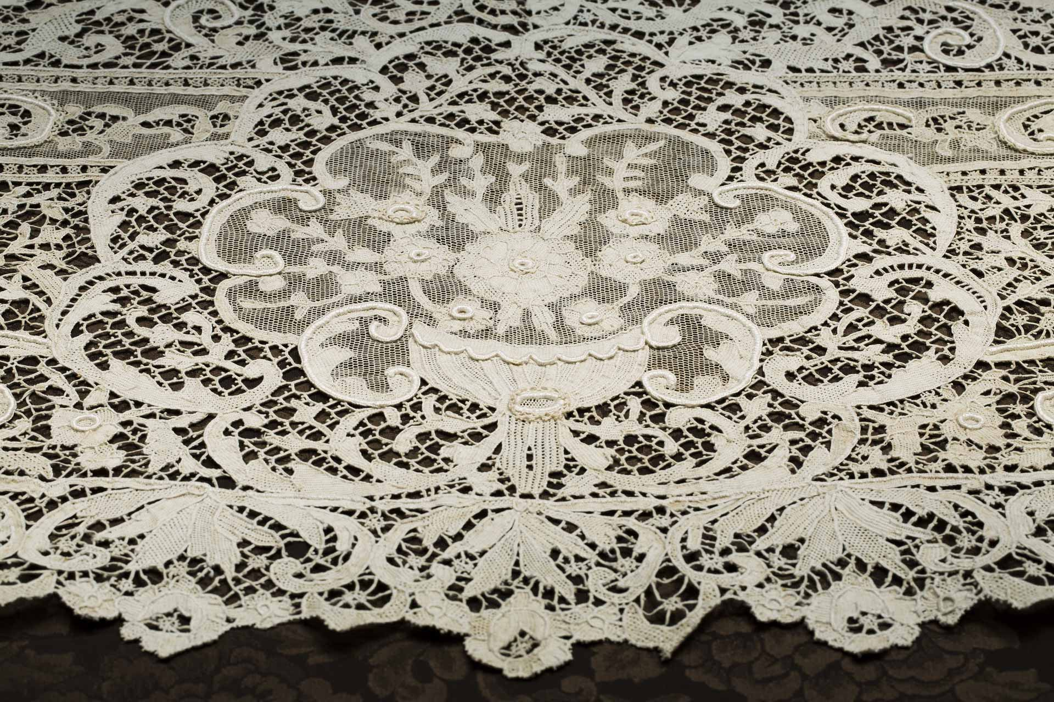
Venice's symbol is the winged lion of Saint Mark.
Venice’s is famous hand-crafted lace and its hand-blown glass.

Slide 12
What have you written on your spider diagram.
Venice

Slide 13
Writing task – Use the facts on your spider diagram to write about Venice. Remember to give your writing a heading.
made up of 118 islands
was built about 1500 years ago
floating city
a city in Italy
buildings are built on wooden platforms
Venice
symbol is a winged lion of Saint Mark
no roads there are canals with boats
2650 alleys
182 canals
417 bridges
72 are private bridges
139 churches
hand-blown glass
hand-crafted lace

Slide 14
Plenary
Today have you learnt today about Venice?
Tomorrow we are going to learn about the different places you can visit in Venice.

