Slide 1
Our new topic is…

Slide 4
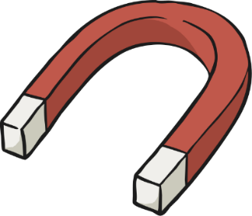
What Do You Know about Forces?
What do you already know about forces?
Do you know anything about magnets?

Slide 5
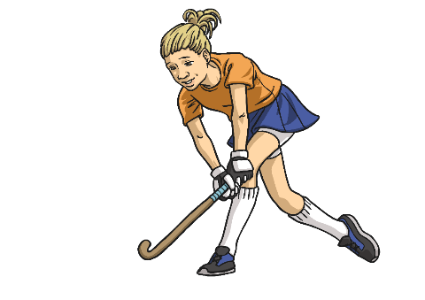
What Is a Force?
A force is a push or pull acting on an object as a result of the object's interaction with another object.
Forces can make objects stop or start moving.
Click the hockey player to watch a clip showing the effects of forces on different objects.
While you are watching, note down any examples of pushes or pulls that you see.

Slide 6
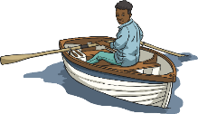
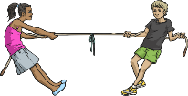
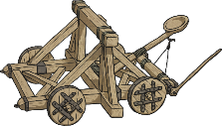
Pushes and Pulls
Did you spot these examples of pulling forces?
The rower pulls the oar.
The tug of war teams pull
the rope.
A catapult is pulled back.
The string of the bow is pulled back.
The bell ringers pull the ropes.
Pulling the sledge.

Slide 7
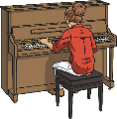
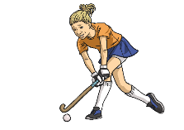
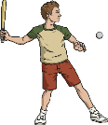
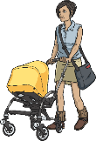
Pushes and Pulls
Did you notice these examples of pushing forces?
The runner's feet push off the ground.
The hockey stick pushes the ball.
A person pushes the piano keys down.
The golf club pushes the golf ball.
The woman pushes the pram.
The bat pushes the ball.

Slide 8
Forces in Action
Can you think of any more pushes or pulls?

Slide 9
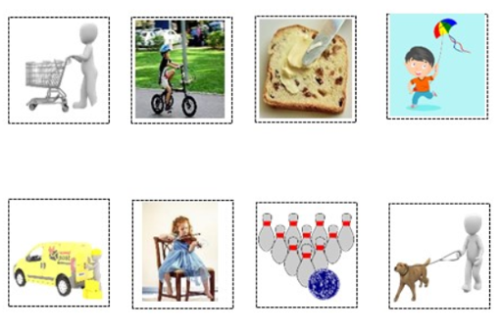
Are they pushing, pulling or both?

Slide 10
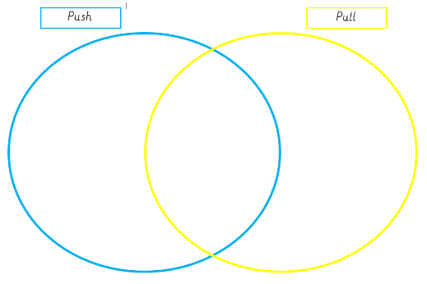
Sort them into your Venn diagram.

Slide 12
Let’s
GO FOR GOLD!
Draw a table and tick the correct box.
Action | Start moving | Stop moving
zip
Pushing a trolley
Catching a ball
Pedalling a bike
Buttering bread
Kicking a ball

