Slide 1
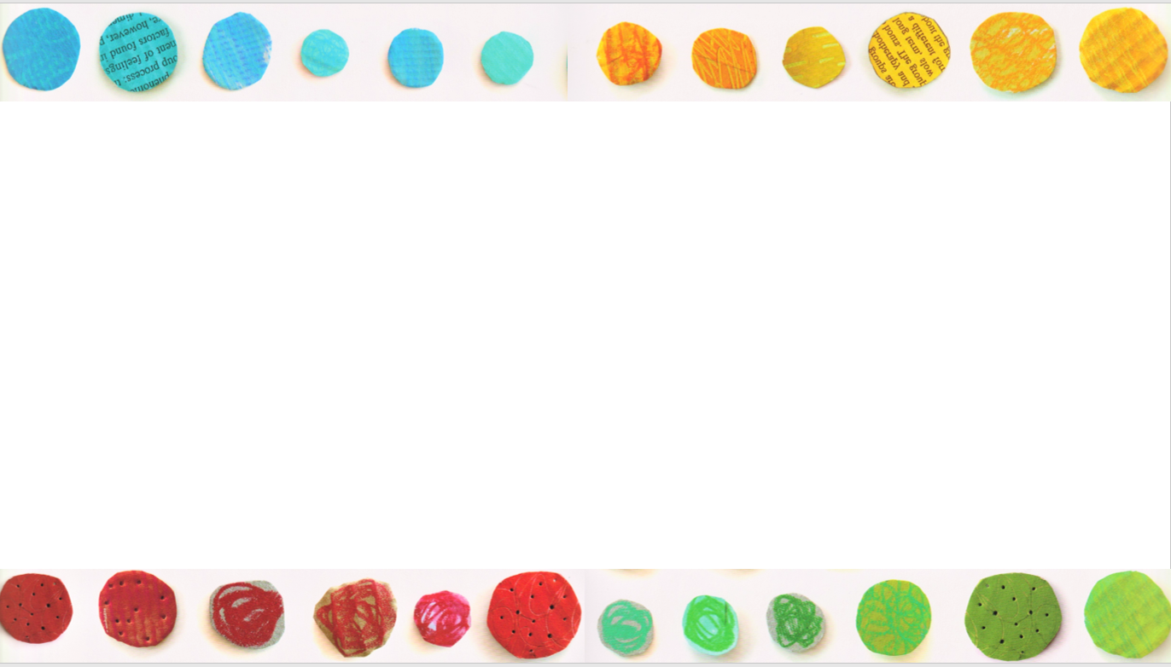
Click the link below to listen to the story “The Colour Monster.”
https://www.youtube.com/watch?v=W6wIEp-M4tg

Slide 2
I can answer comprehension questions to show my understanding of the story.

Slide 3
This is my friend the colour monster.
Today he’s all mixed up and very confused.
He doesn’t know why.
Look at you, you’re all over the place!
That’s because your feelings are all stirred together, so your colours are too.
1. How is the colour monster feeling today?
Mixed up and very confused.

Slide 4
This is my friend the colour monster.
Today he’s all mixed up and very confused.
He doesn’t know why.
Look at you, you’re all over the place!
That’s because your feelings are all stirred together, so your colours are too.
His feelings are all confused so his colours are too.
2. Why is the monster feeling like this?

Slide 5
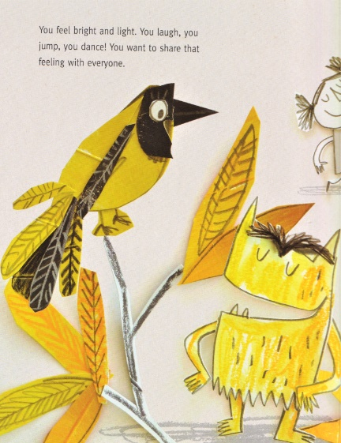
This is happiness. It shines yellow like the sun and twinkles like the stars.
You feel bright and light.
You laugh, you jump, you dance!
You want to share that feeling with everyone.
Bright Light
3. Find and copy two adjectives to describe how happiness can make you feel.

Slide 6
This is happiness. It shines yellow like the sun and twinkles like the stars.
You feel bright and light.
You laugh, you jump, you dance!
You want to share that feeling with everyone.
Laugh Jump Dance
4. Name three things that happiness makes you want to do.

Slide 7
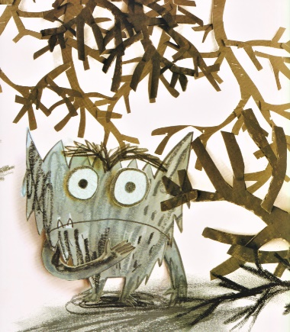
This is fear. It is black like the night and hides in shadows like a scaredy cat.
Being afraid can make you feel very small and alone.
If you’re scared, tell me why and we’ll walk through the forest together.
Fear hides in shadows.
5. Where does fear hide?

Slide 8
This is fear. It is black like the night and hides in shadows like a scaredy cat.
Being afraid can make you feel very small and alone.
If you’re scared, tell me why and we’ll walk through the forest together.
He could tell someone so they can help him face his fears.
6. What could monster do when he is feeling scared?

Slide 9
I can answer comprehension questions to show my understanding of the story.

Slide 11
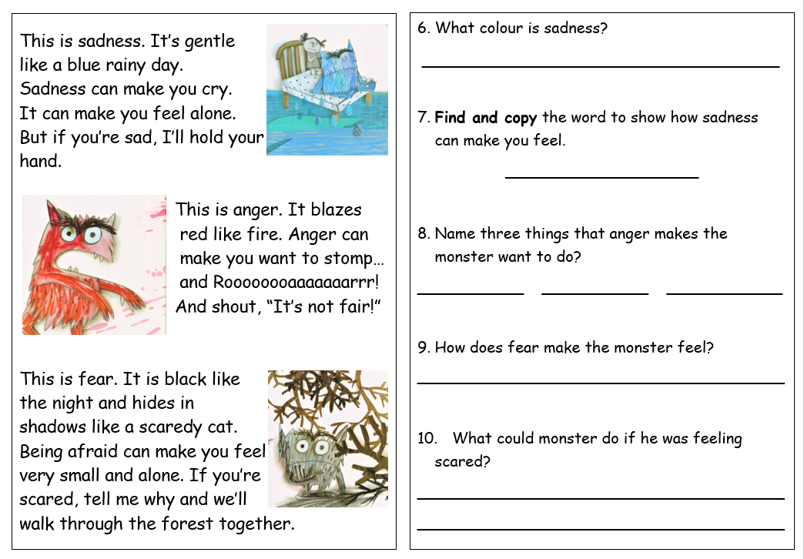

Slide 12
